Slide 1
TierTrain: Proactive Memory Tiering for CPU-Based DNN Training
Sathvik Swaminathan, Sandeep Kumar, Aravinda Prasad, and Sreenivas Subramoney
International Symposium on Memory Management (ISMM), 2025

Slide 2
Outline
Motivation
Background
Observation
Proposal: TierTrain
Results
Conclusion and Future Work

Slide 3
Motivation
Memory cost, Model Size

Slide 4
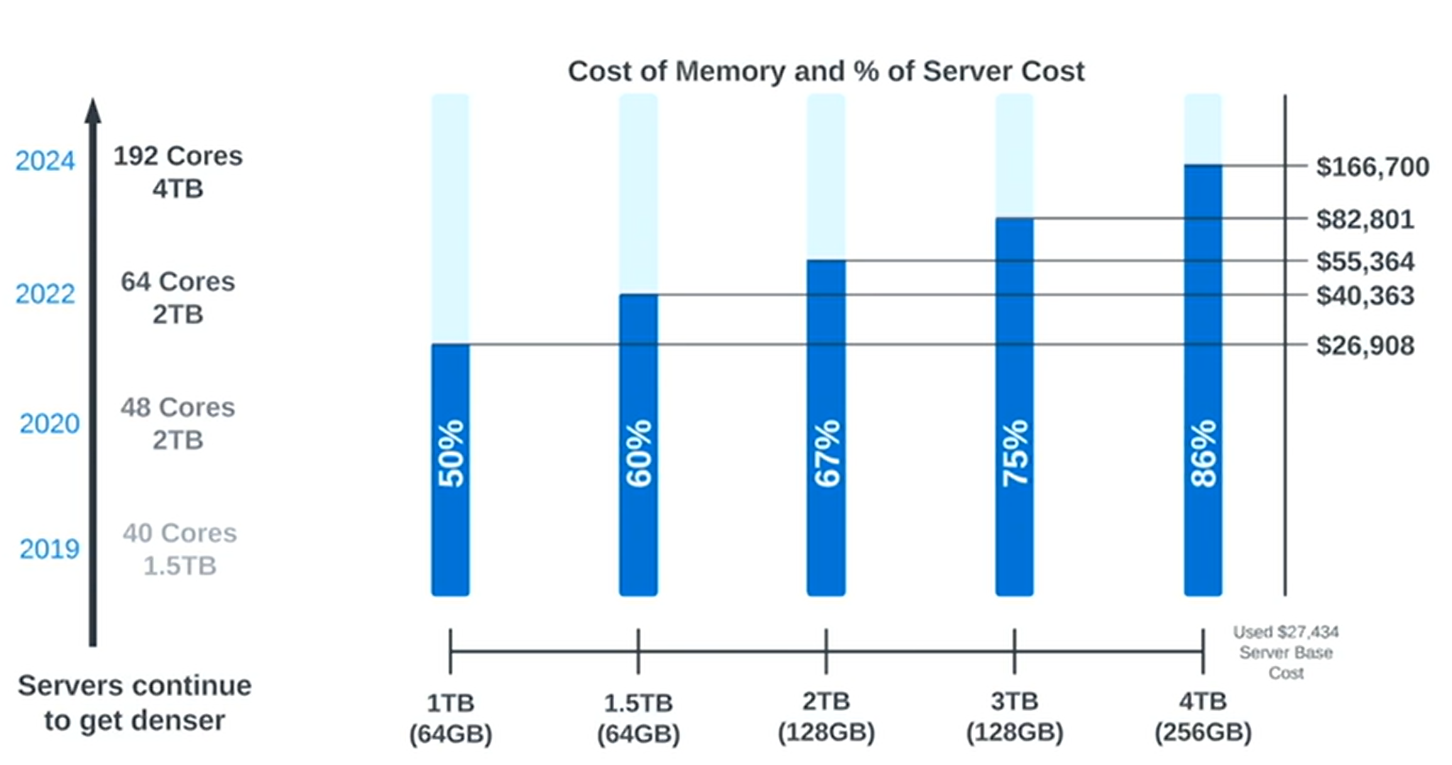
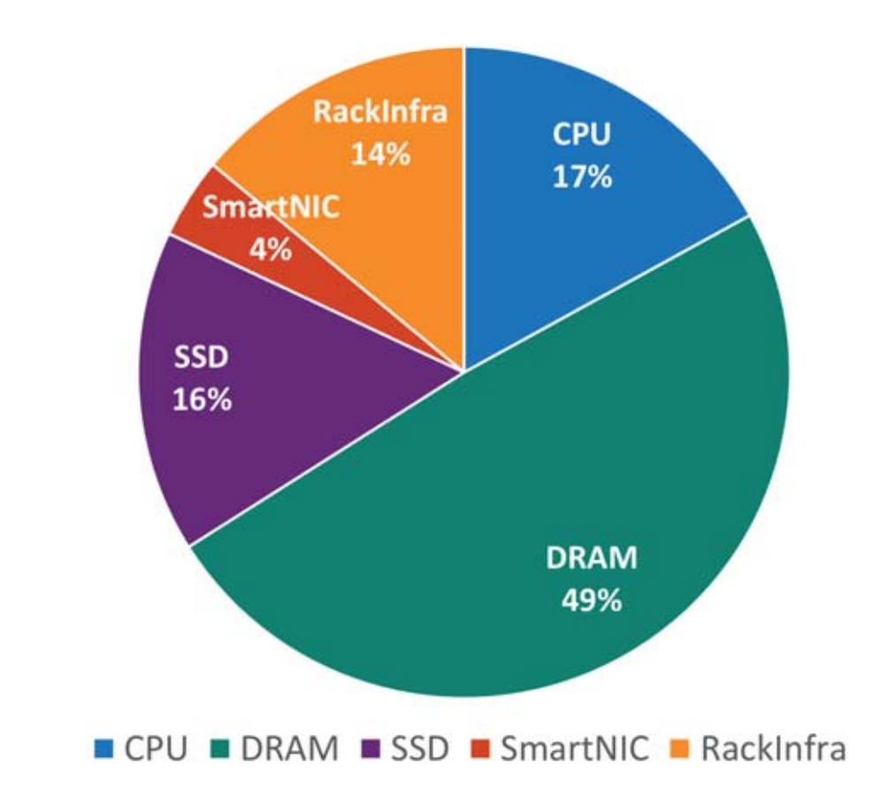
Motivation Tiered Memory Systems – Why DRAM isn’t enough
Economics
“The cost of DRAM is 50%-90% the cost of the server” – Vmware
DRAM accounts for ~50%
of server cost
Source: Memory Tiering: Power Your Server Infrastructure with Memory Innovations
https://www.vmware.com/explore/video-library/video/6360757998112
Source: 2021 Decadal Plan for Semiconductors by Semiconductor Research Corporation (SRC)
https://www.src.org/about/decadal-plan/decadal-plan-full-report.pdf

Slide 5
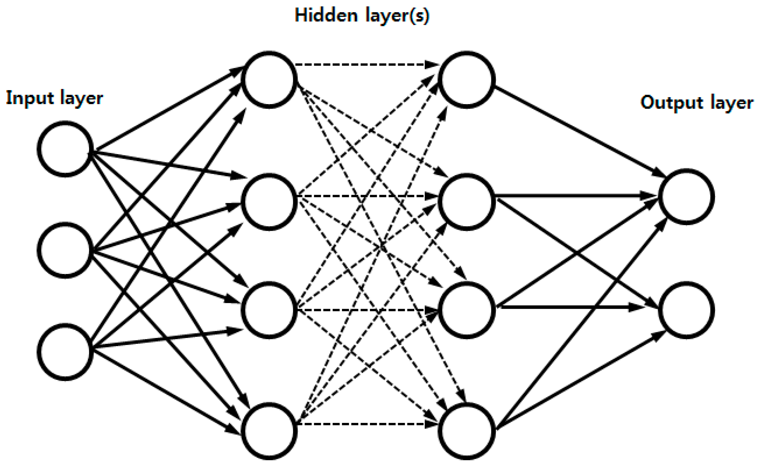
Motivation
Model size ↑ => Memory requirements ↑
Large models => Memory wall problem
Solution => Memory tiering

Slide 6
Background
Memory Tiering

Slide 7
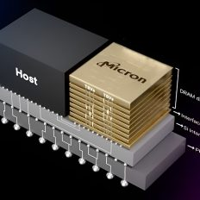
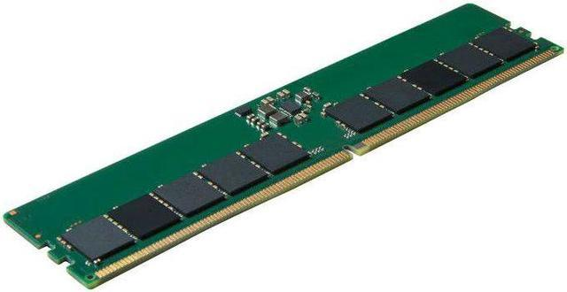
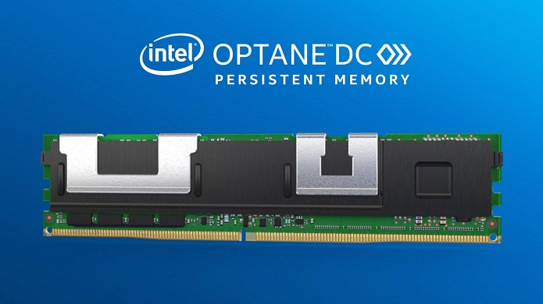
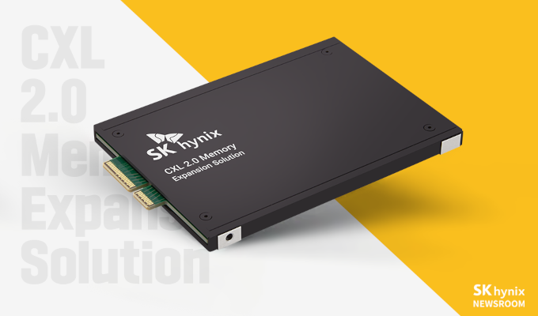
Background – Memory Tiering
Latency low Bandwidth high
Capacity low
Cost/byte high
Latency high Bandwidth low
Capacity high
Cost/byte low
Memory
SRAM Caches
Storage
HOT MEMORY TIERS
COLD MEMORY TIERS
HBM
DDRx /DRAM
NVMs /
Persistent Memory
CXL Memory Pooling/Expansion
Heterogeneous memory systems with multiple memory tiers
Place frequently accessed hot data in fast memory and cold data in slow memory

Slide 8
Observation
Memory Access Pattern

Slide 9
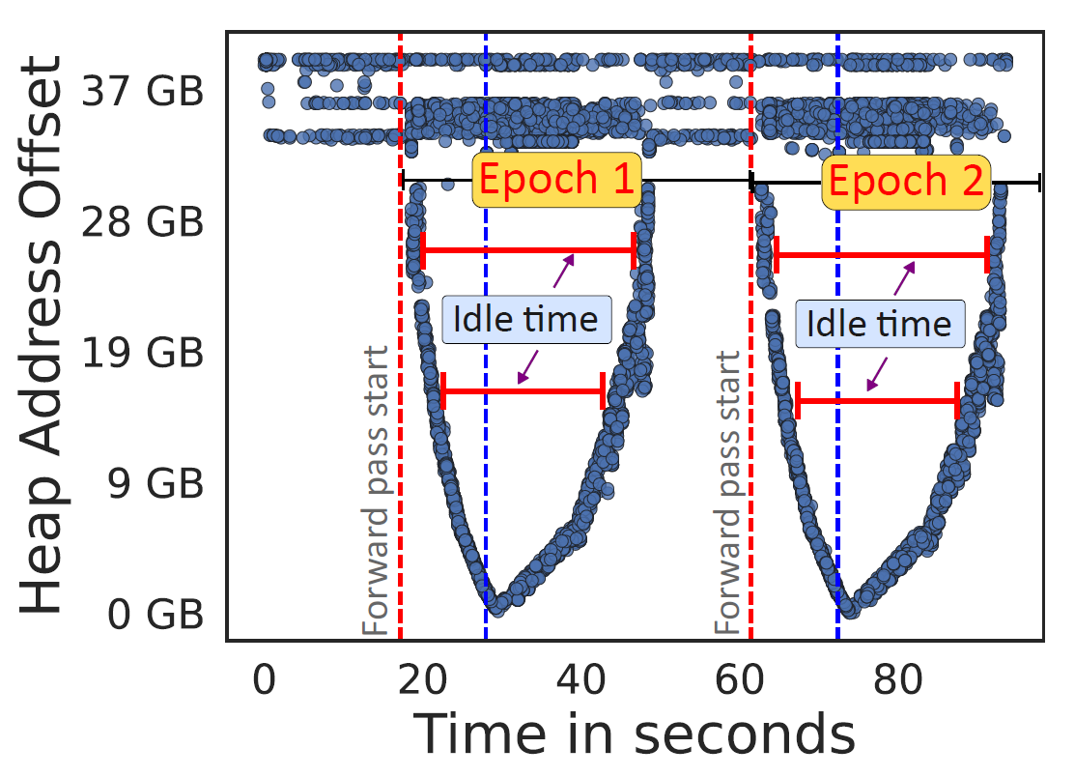
Key Observation
DNN Training – Memory Access Pattern
Epoch 1
Epoch 2
Tensors from forward pass get reused only during backward pass
These tensors are idle before getting reused
Can be aggressively moved to slow tier when idle

Slide 10
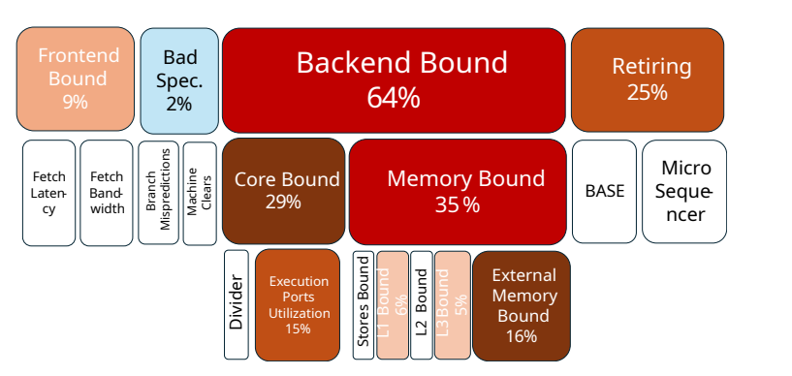
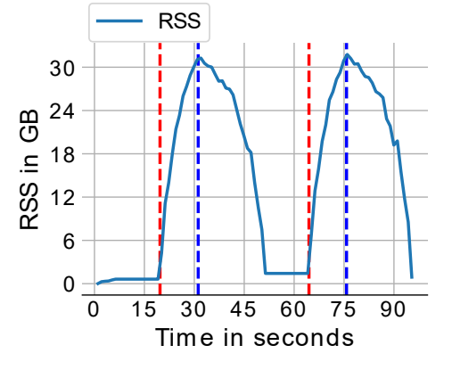
Key Observation
DNN Training – TMA & Memory Footprint
ResNet-34 on CIFAR-10
Top-Down Analysis
RSS
DNN Training workloads are bound by external memory bandwidth

Slide 11
Proposal
TierTrain

Slide 12
Comparison against state-of-the-art techniques
TierTrain
Pro-active
Prefetch
Others
Slow
Misses on prefetch
Domain specific

Slide 13
TierTrain in action
DNN Training workload
3
Upon Layer finish in forward pass
2
Trigger eviction
(may modify
Size)
4
TierTrain
Eviction/Prefetch Queue
1
Hooks
Migrate pages
6
Get Stats
Layer execution timing and Tensor details (size, address)
5
Periodically in backward pass
Prefetch?
7
Yes

Slide 14
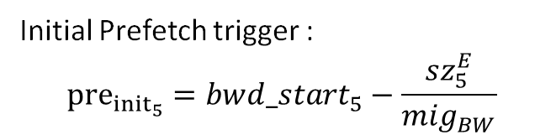
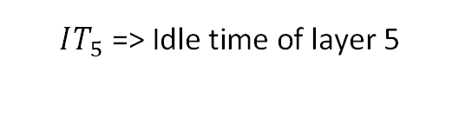



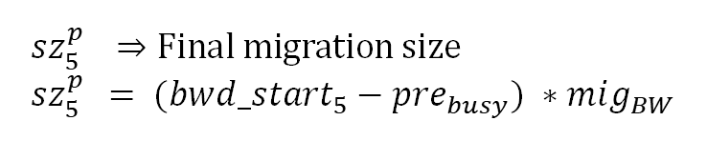


Queuing System - Eviction and Prefetch triggers
Forward Pass
Backward
Pass
$$IT_{5}\text{ => }\text{Idle} \text{time} \text{of} \text{layer}\text{ 5}$$
L1
L5
L10
L10
L5
L1
Saved tensor: $T_{5 }$
$${pre}_{{init}_{5}}=10s$$
$${pre}_{{final}_{5 }}=10.7s$$
Eviction Equations
$$sz_{5 }^{E}⇒Intial computed eviction size$$
Prefetch Equations
Prefetch queue
Final Prefetch trigger:
$${pre}_{{final}_{5}}=pre_{busy}$$
When prefetcher becomes free
$sz_{5 }^{E}={min⁡(T}_{5 }, IT_{5} ∗\frac{mig_{BW}}{2})$
Initial Prefetch trigger :
$${pre}_{{init}_{5}}=bw{d_start}_{5}−\frac{sz_{5}^{E}}{mig_{BW}}$$
L6
$$sz_{5 }^{p} ⇒Final migration size$$
$$sz_{5 }^{p}= (bw{d_start}_{5}−pre_{busy}) ∗mig_{BW}$$
L5
…..
…..
Prefetch over
at t = 10.7s
Start time of layer 5 in backward pass

Slide 15
Evaluation and Results

Slide 16
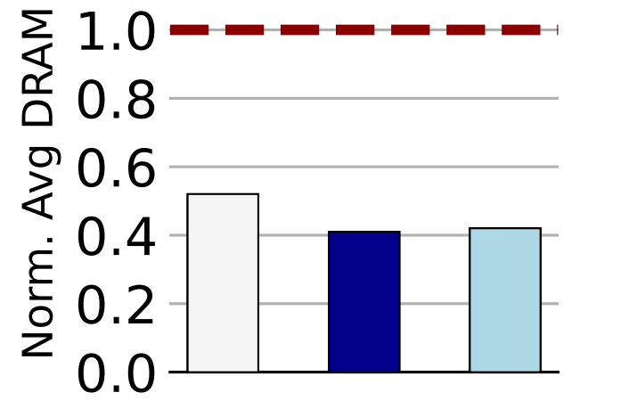
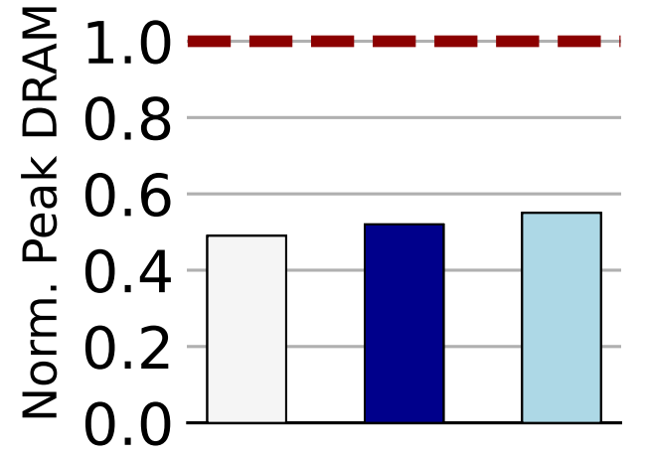
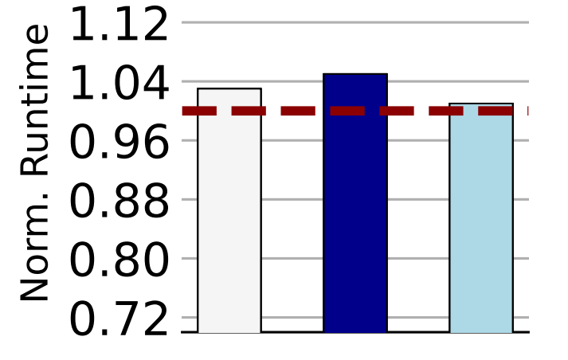
TierTrain: CXL evaluation
System Settings
Model: Intel(R) Xeon(R) CPU Max 9480 | DRAM: 2 TB
CPUs: 2 Socket, 56 Cores, 2 HT | CXL: 256 GB
Avg DRAM
Peak DRAM
Performance
Highlights
Average DRAM reduction of 48–59%
Peak DRAM reduction of 45–51%
Perf impact of 1-5%
Baseline: Pure DRAM execution

Slide 17
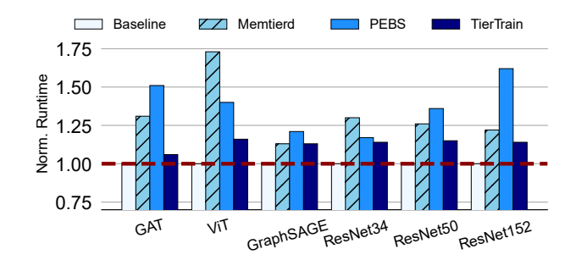
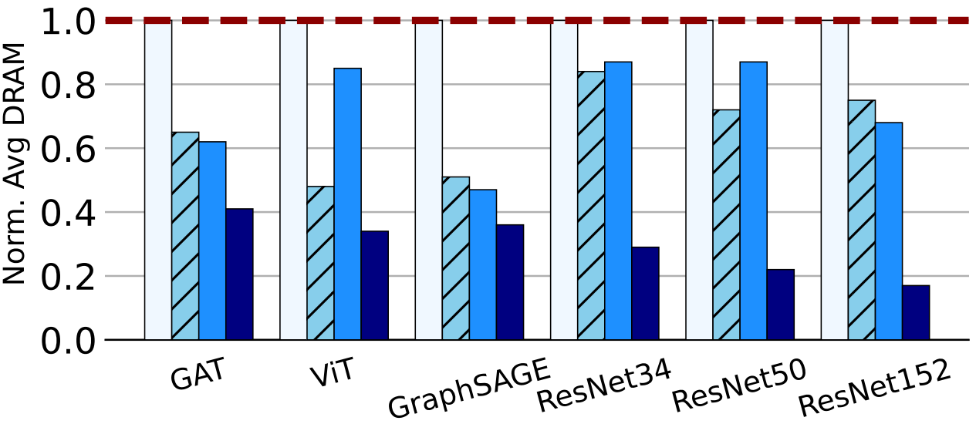
TierTrain vs SOTA – TCO Benefits
System Settings
Model: Intel(R) Xeon(R) Gold 6238M | DRAM: 768 GB
CPUs: 4 Socket, 22 Cores, 2 HT | Optane: 4.5 TB
Reduction in Avg. DRAM
Performance benefit
Highlights
Average DRAM reduction of 59–83%
Peak DRAM reduction of 25–74%
Baseline: Pure DRAM execution
Notes:
Memtier
1TB
200K Keys
5MB
Guassian
YCSB
2TB
40 Mins
Hotspot

Slide 18
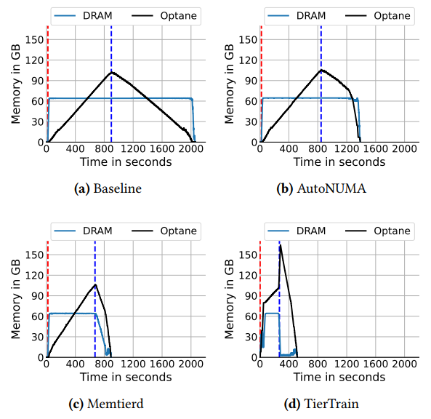
TierTrain: DRAM-Constrained Scenario
System Settings
(single socket)
Model: Intel(R) Xeon(R) Gold 6238M
CPUs: 4 Socket, 22 Cores, 2 HT
DRAM: 60 GB
Optane: 1.1 TB
ResNet-152 on CIFAR10
Footprint: 150 GB
TierTrain outperforms Memtierd, HeMem, and AutoNUMA by 35%, 37%, and 84%, respectively in terms of epoch execution time

Slide 19
Future Directions
Inter-epoch tiering
Tcmalloc – popular choice for DNN Training
Memory is not freed between epochs
Additional tiering opportunities

Slide 20
Thank you

