Slide 1
TierScape: Harnessing Multiple Compressed Tiers to Tame Server Memory TCO
EuroSys 2026
Sandeep Kumar, Aravinda Prasad*, and Sreenivas Subramoney*
Intel, India
* Work done while at Intel

Slide 2
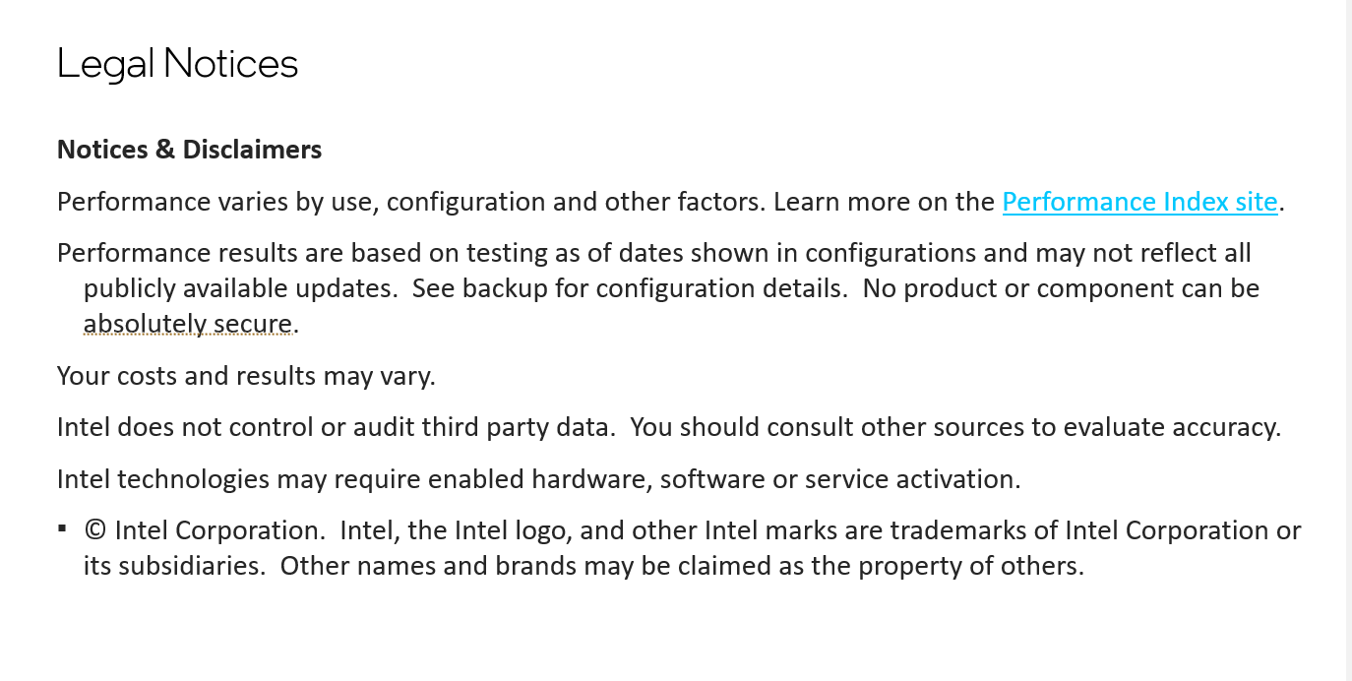

Slide 3
Outline
01
Memory Total Cost of Ownership (TCO) Problem
02
Hardware and Software Memory Tiers
03
TierScape
04
Implementation & Evaluation
05
Conclusion and Future Work

Slide 4
Memory Total Cost of Ownership (TCO) Problem
Memory Tiering and Limitations of current Tiering Techniques

Slide 5
The Memory TCO Problem
50–90%
is memory TCO
On general-purpose large systems Memory accounts for 50–90% of Server TCO [1]
Memory demand escalating fast as modern workloads break TB barrier
Imperative to solve memory TCO
↑ TB+
Moden Workloads
Memory Tiering
Solution for memory TCO
[1]: VMware. 2024. Memory Tiering: Power Your Server Infrastructure with Memory Innovations. https://youtu.be/v9bJp8zpJ8s?t=1849

Slide 6
Memory Tiering on a Modern System
Access
Profile
Native app 1
Native app 2
App
Userspace
Intel PEBS
DAMON
PT-Based
Telemetry
VM
Data placement decision policies
Operating System
Kernel
Page Table (PT)
Hardware Counters
Hot Memory Tier
Cold Memory Tier
Hardware
High Cost
Low Latency
Low Capacity
Large Gap
Low Cost
High Latency
High Capacity

Slide 7
Limitations of Current Tiering
Typical Data Center Memory Access Profile [2]
Hot
Warm (50–60%)
Cold
10–20%
Untapped opportunity
20–30%
Tiered
❶ Limited cold data (20–30%) → limited TCO savings potential
❷ Aggressive placement of Warm Data results in unacceptable penalty
❸ Warm pages (50–60%) left on the table
How to enable tiering of warm data?
[2]: TMO: Transparent Memory Offloading in Datacenters, ASPLOS’22

Slide 8
Hardware and Software Memory Tiers
Tiers and the corresponding performance and TCO savings

Slide 9
Multiple Hardware and Compressed Tiers
Zswap - A compressed memory tier
Distinct Compressed Tiers
Compression Algorithm
Lz4, lzo, deflate, zstd
Pool Allocator
zbud, z3fold , zsmalloc
Hardware Memory Tier
×
Kernel
×
Hardware memory tiers:
DRAM
Fast Memory
HBM
High Bandwidth Mem.
NVMM
Non-Volatile Mem.
CXL Memory
CXL-attached
Hardware
Notes:
Also given set of data. But that cannot be parametrized.

Slide 10
Tier Characterization: Latency vs. TCO – Given a Workload
Max TCO
savings
High
C12
deflate / zsmalloc Optane
Balanced
Cold pages zone
Fast + dense
packing
C7
lzo / zsmalloc DRAM
Data management in a multi-tier setup – How to manage the tiers?
TCO Savings →
Low latency,
cheaper media
C4
lz4 / zsmalloc Optane
C2
lz4 / zbud Optane
Fastest access,
low savings
C1
lz4 / zbud DRAM
Low
Warm pages zone
Low
Access Latency →
High
DRAM
Notes:
For a given set of data.

Slide 11
TierScape - Models
Placement models – Maximum TCO Savings with Minimum Performance Overhead

Slide 12
Placement Models – Waterfall Model
Upfront memory TCO savings
1
Application
DRAM
T+1
Gradually moved to tiers with better memory TCO savings
Tier 1
T+2
2
Improved TCO savings &
Drop in performance
Profiler
Tier 2
T+3
Tier 3
TierScape
…
T+N
Waterfall
Tier N
Miss the opportunity for aggressive TCO savings
!
An access promotes a page immediately back to DRAM, and the journey starts again.

Slide 13

Placement Models – Analytical Model (AM)
Tunable Knob
TCO to be saved while minimizing performance loss.
Application
DRAM
1
Tier 1
Profiler
Improved TCO savings &
Drop in performance
Tier 2
Tier 3
Quick Convergence
Cold data are directly placed in the optimal tier.
TierScape
…
$$α$$
AM Model
Tier N
2
User
Input

Slide 14
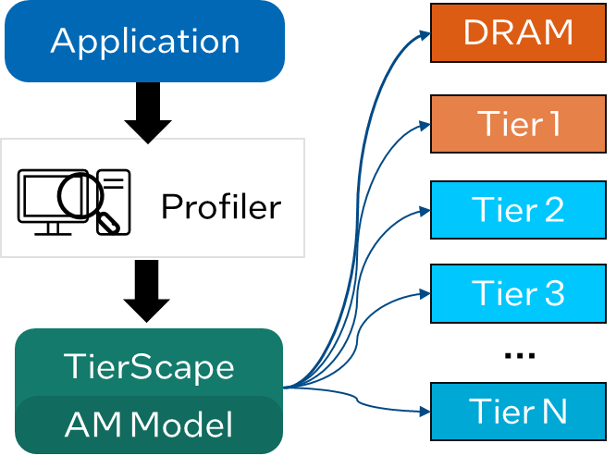
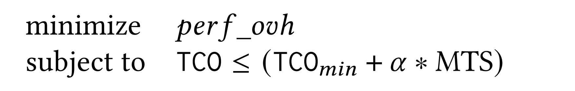

Analytical Model – User Tunable Parameter
Max TCO
DRAM
Max TCO Savings (MTS)
Tier N
Min TCO
0
1
Knob
$$α$$
TCO Optimized
Perf. Optimized

Slide 15
Implementation & Evaluation
Linux kernel changes, TS-Daemon, and experimental results

Slide 16
TierScape Implementation
USERSPACE
TS-Daemon
PEBS Profiler
ILP Solver
Filter
KERNEL
Extended zswap
Multi-tier zpool
madvise() hook
struct page augmented with tier metadata
MEMORY TIERS
DRAM
NVMM

Slide 17
Evaluation – Tiers Combination
4-Tier Setup
6-Tier Setup
DRAM
Byte-addressable
None · N/A · DRAM
DRAM
None · N/A · DRAM
C1
LZ4 · zbud · DRAM
Optane
Byte-addressable
None · N/A · Optane
C2
LZ4 · zbud · Optane
CT-1
Compressed tier
LZO · zsmalloc · DRAM
C3
LZ4 · zsmalloc · Optane
C4
LZO · zsmalloc · DRAM
CT-2
Compressed tier
Zstd · zsmalloc · Optane
C5
Deflate · zsmalloc · Optane

Slide 18
Results: TCO Savings vs. Perf. Slowdown (Memcached)
Percentage Points
4-Tiers Setup different tiering solutions
6-Tiers Setup different α values
TCO Optimized
Perf Optimized

Slide 19
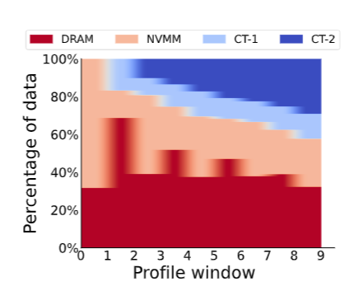
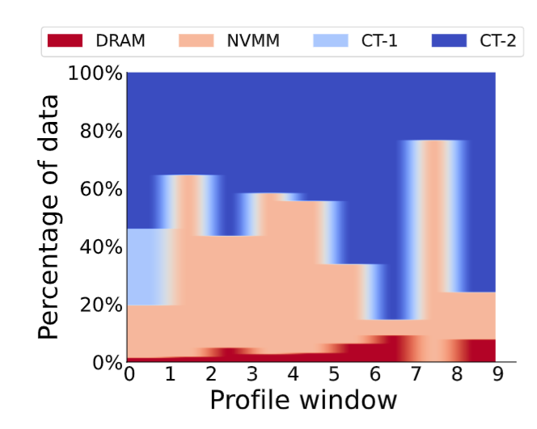
Evaluation – 4-Tier – Memcached
Data placement recommendations by Waterfall Model
Data placement recommendations by AM Model

Slide 20
Conclusion and Future Work

Slide 21
Conclusion
We demonstrate TCO savings for warm data
Low-latency compressed tiers enable warm page compression with acceptable penalty
1
Rigorous analytical cost model with tunable knob
ILP-based optimization for direct, optimal page placement across N tiers
2
Comprehensive evaluation with real-world workloads
15–24 pp better TCO (perf parity) or 3–10 pp better perf (TCO parity)
3

Slide 22
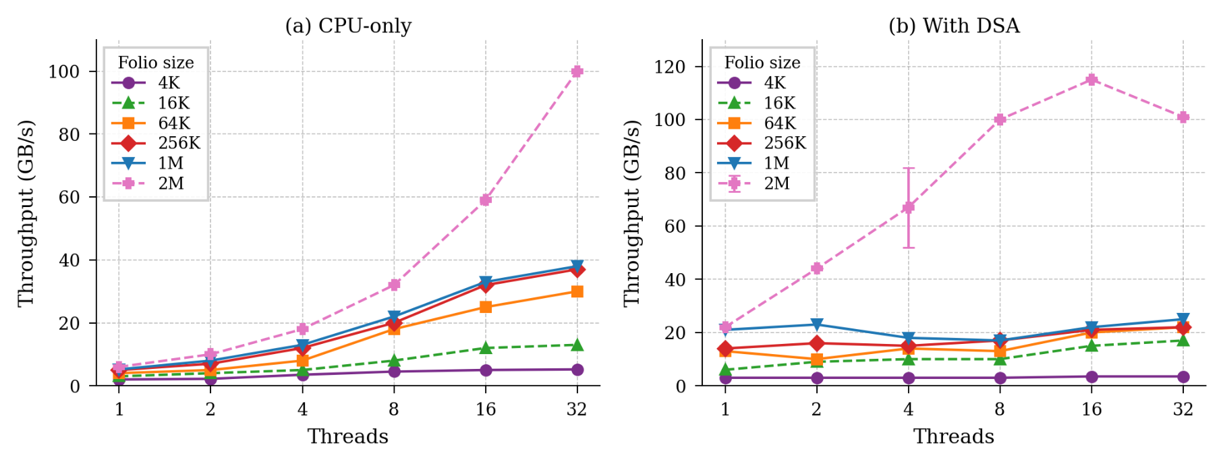
Future Work
Optimal tier choice and ideal number of tiers
Use of accelerators for data movement among tiers
1
2
*Work in Progress: Move_pages performance with DSA. Results might change.

Slide 23
Thank you for attending!
Code: https://github.com/IntelLabs/tierscape
Contact: sandeep4.kumar@intel.com

