Slide 1
Radiant: Efficient Page Table Management for Tiered Memory Systems
Sandeep Kumar*#, Aravinda Prasad*, Smruti R. Sarangi#, Sreenivas Subramoney*
* Processor Architecture Lab at Intel Labs, India
# Indian Institute of Technology Delhi, India
International Symposium on Memory Management, 2021

Slide 2
Outline
Background
Proposed techniques
Evaluation
Motivation
Observation

Slide 3
Background

Slide 4
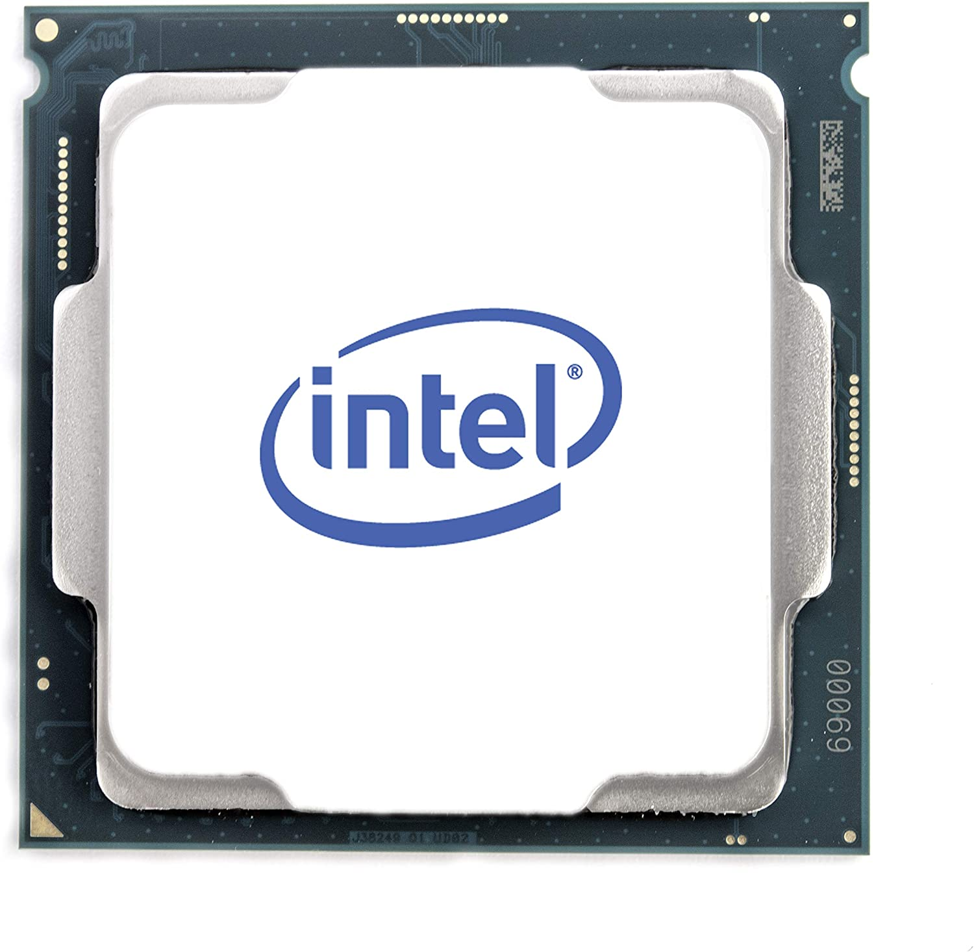
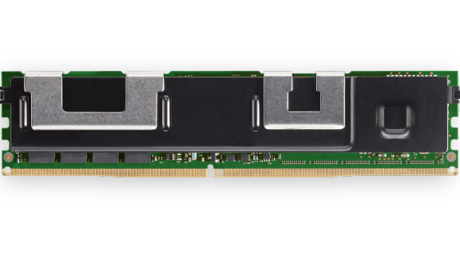
Background
CPU
SYSTEM BUS
DRAM
Optane
Notes:
Traditional computing, in terms of DRAM accesses.

Slide 5
Background: Optane configuration
Used in the paper
1
2
DRAM acting as cache
DRAM
Optane
Unified byte-addressable memory.
Optane as a main memory
The operating system recognizes these as different NUMA nodes.
Notes:
The other design gives some flexibility to the OS.
The OS can make decisions regarding placement of data.
The memory shows up as NUMA nodes. However, there is one difference, they are CPU-less NUMA nodes.

Slide 6
Background: Comparison
DRAM
Low latency
Low capacity
Optane
High latency
High capacity
Persistence
Many prior works
User Data
Heap
Kernel Data
Page Tables
Kernel objects
This paper
KLOCs
ASPLOS '21
Hot data in DRAM and cold data in Optane
Notes:
However, this comes up at cost of higher access latency because of the hardware components.

Slide 7
The Page Table
2TB of data pages require 4GB of page table pages
The page table
Level 1 or PGD pages
Level 2 or PUD pages
Level 3 or PMD pages
Level 4 or PTE pages
Data pages
Process address space
Notes:
FIX THE SIZE
Now, the crucial thing, that none of the work presently address are the extra pages that are used to support the virtual memory management in a Linux kernel.
Let us suppose this is the process address space and assume that the process is has populated all the entries, with some of it being hot.
To enable virtual memory, basically the mapping from the virtual address to physical address is stored in the page table pages.
Points:
Now, for a memory intensive application, typical for a workload running on Optane, the size of the page table pages can be significant. For e.g. [ANIMATION]
Now, to ease the finding of an entry, this structure is organized as a tree, and is called page table.
To resolve a mapping, in the worst case, we need to access memory 4 times more

Slide 8
Motivations

Slide 9
Allocation Policies
NUMA Node 1
NUMA Node 2
NUMA Node 3
NUMA Node 4
NUMA Node 1
NUMA Node 2
NUMA Node 3
NUMA Node 4
Increasing distance from the CPU
Increasing distance from the CPU
First-touch policy
Interleaved policy

Slide 10
Page Table Allocation
Free pages
Interleaved memory allocations
Data pages
PT pages
DRAM
Optane
Page table pages in Optane, even when DRAM is free.

Slide 11
Page Table Migration
DRAM
Optane

Slide 12
Page Table Migration
Process A’s Data page
Process A’s Page table page
Process A’s allocations on DRAM
DRAM
Optane

Slide 13
Page Table Migration
Process A’s Data page
Process B’s Data page
Process A’s Page table page
Process B’s Page table page
Process A’s allocations on DRAM
Process B’s allocations on Optane
DRAM
Optane

Slide 14
Page Table Migration
Process B’s Data page
Process B’s Page table page
Process A quits
DRAM
Optane
Migrate Process B’s data page to DRAM

Slide 15
Page Table Migration
Process B’s Data page
Process B’s Page table page
Page table pages are stuck in Optane
DRAM
Optane

Slide 16
Summary
Page Table Allocation
Page table migration
Data pages can move across NUMA nodes
Page table pages are fixed
Allocations are dynamic
Follows data page allocation policy
Page table pages can end up in Optane even when DRAM is free

Slide 17
Observations

Slide 18
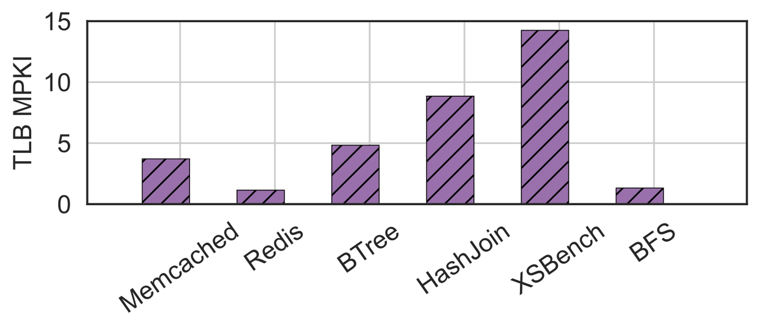
Observation:
Large memory foot-print applications have a high TLB miss-rate.
A High-TLB miss rate implies more page table walks.
High TLB miss rate
More page walks
High TLB miss rate implies more page table walk.
Notes:
The TLB stores the recently used VA to PA mappings.
The TLB reach has not increased. Hence, an application with large memory working set will have a high TLB rate - incurring many page table walks.
Hence, optimizing page table walks is important.

Slide 19
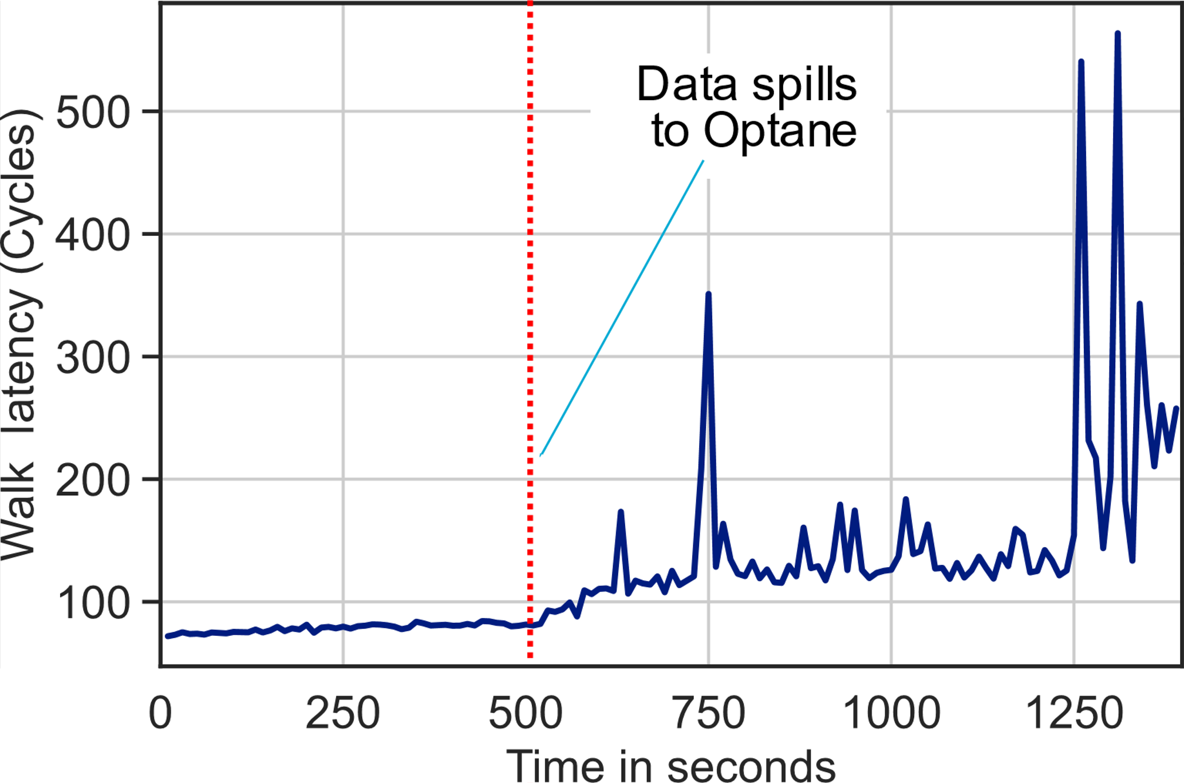
Observation:
High page walk latency when page table pages are in Optane.
Page table page placement is crucial.
Memcached inserting 1TB of data

Slide 20
Naïve approach

Slide 21
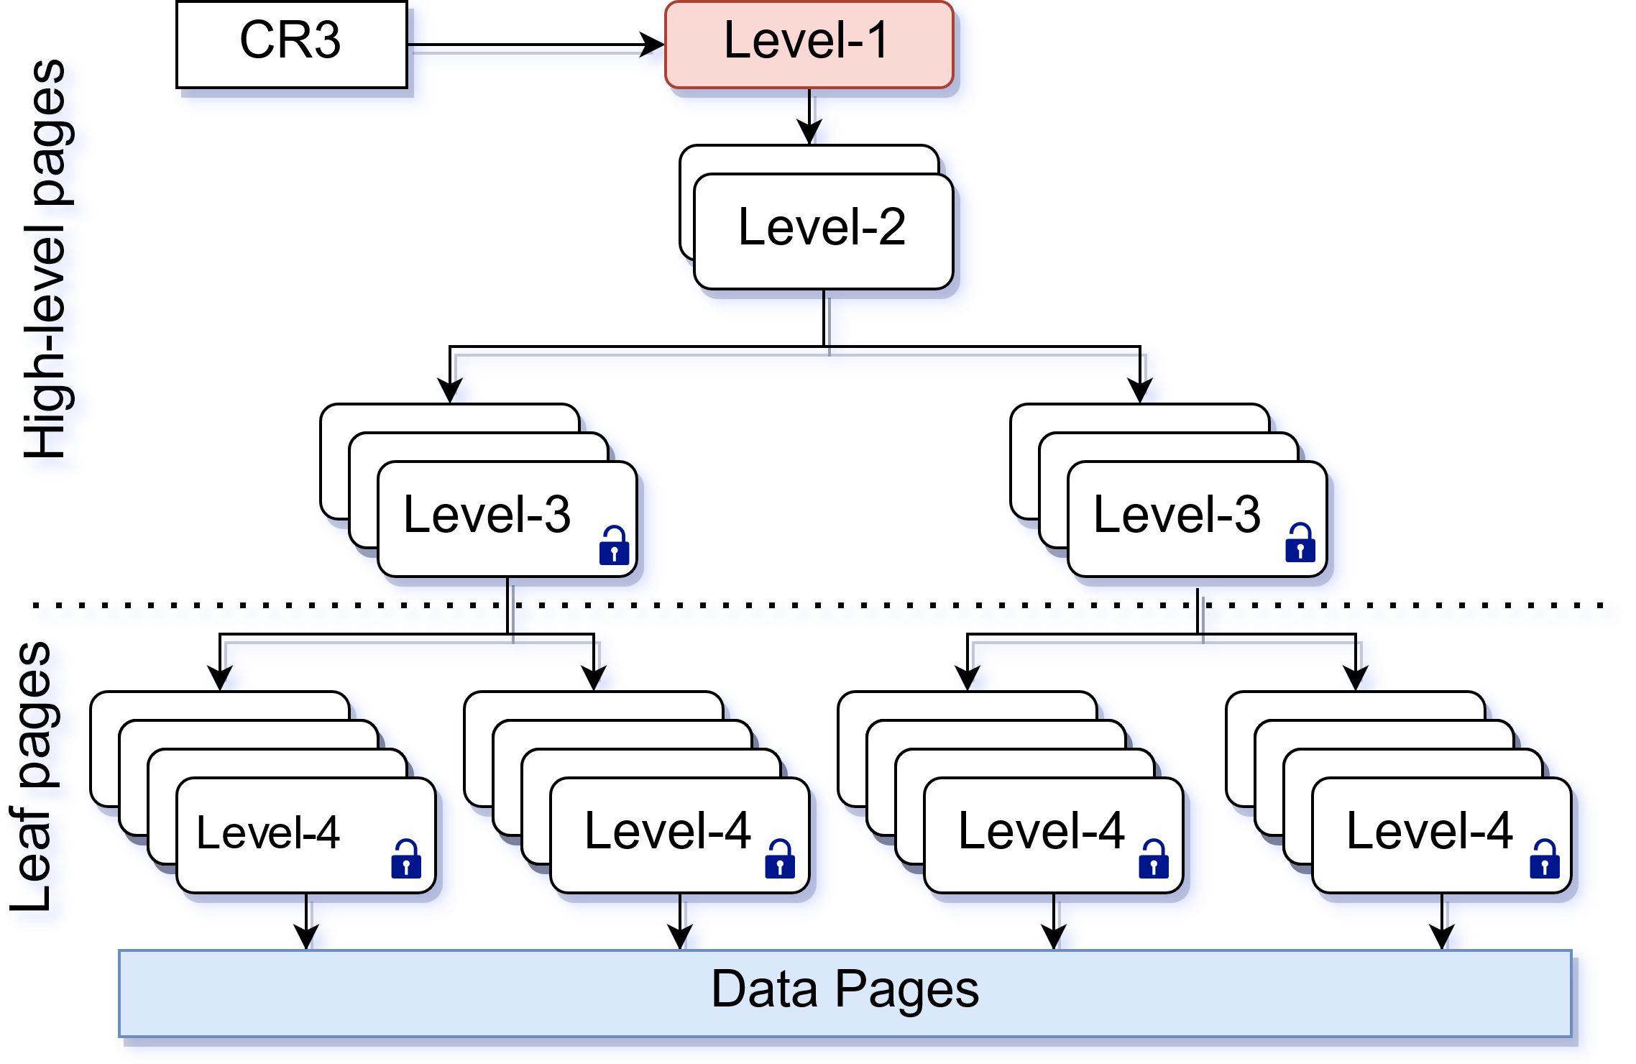
Bind-All *
Pros:
Fast access to all the levels of the page table during a walk
Cons:
Pathological cases
* Proposed by Linux kernel developers, but it was not accepted in the kernel.
Pin all the pages to DRAM

Slide 22
Problems with Bind-all
Free memory in Optane
Kernel working hard to accommodate
page table pages in DRAM
High latency of page table page allocation
OOM !!
Data in Optane
DRAM
Optane

Slide 23
Proposed techniques

Slide 24
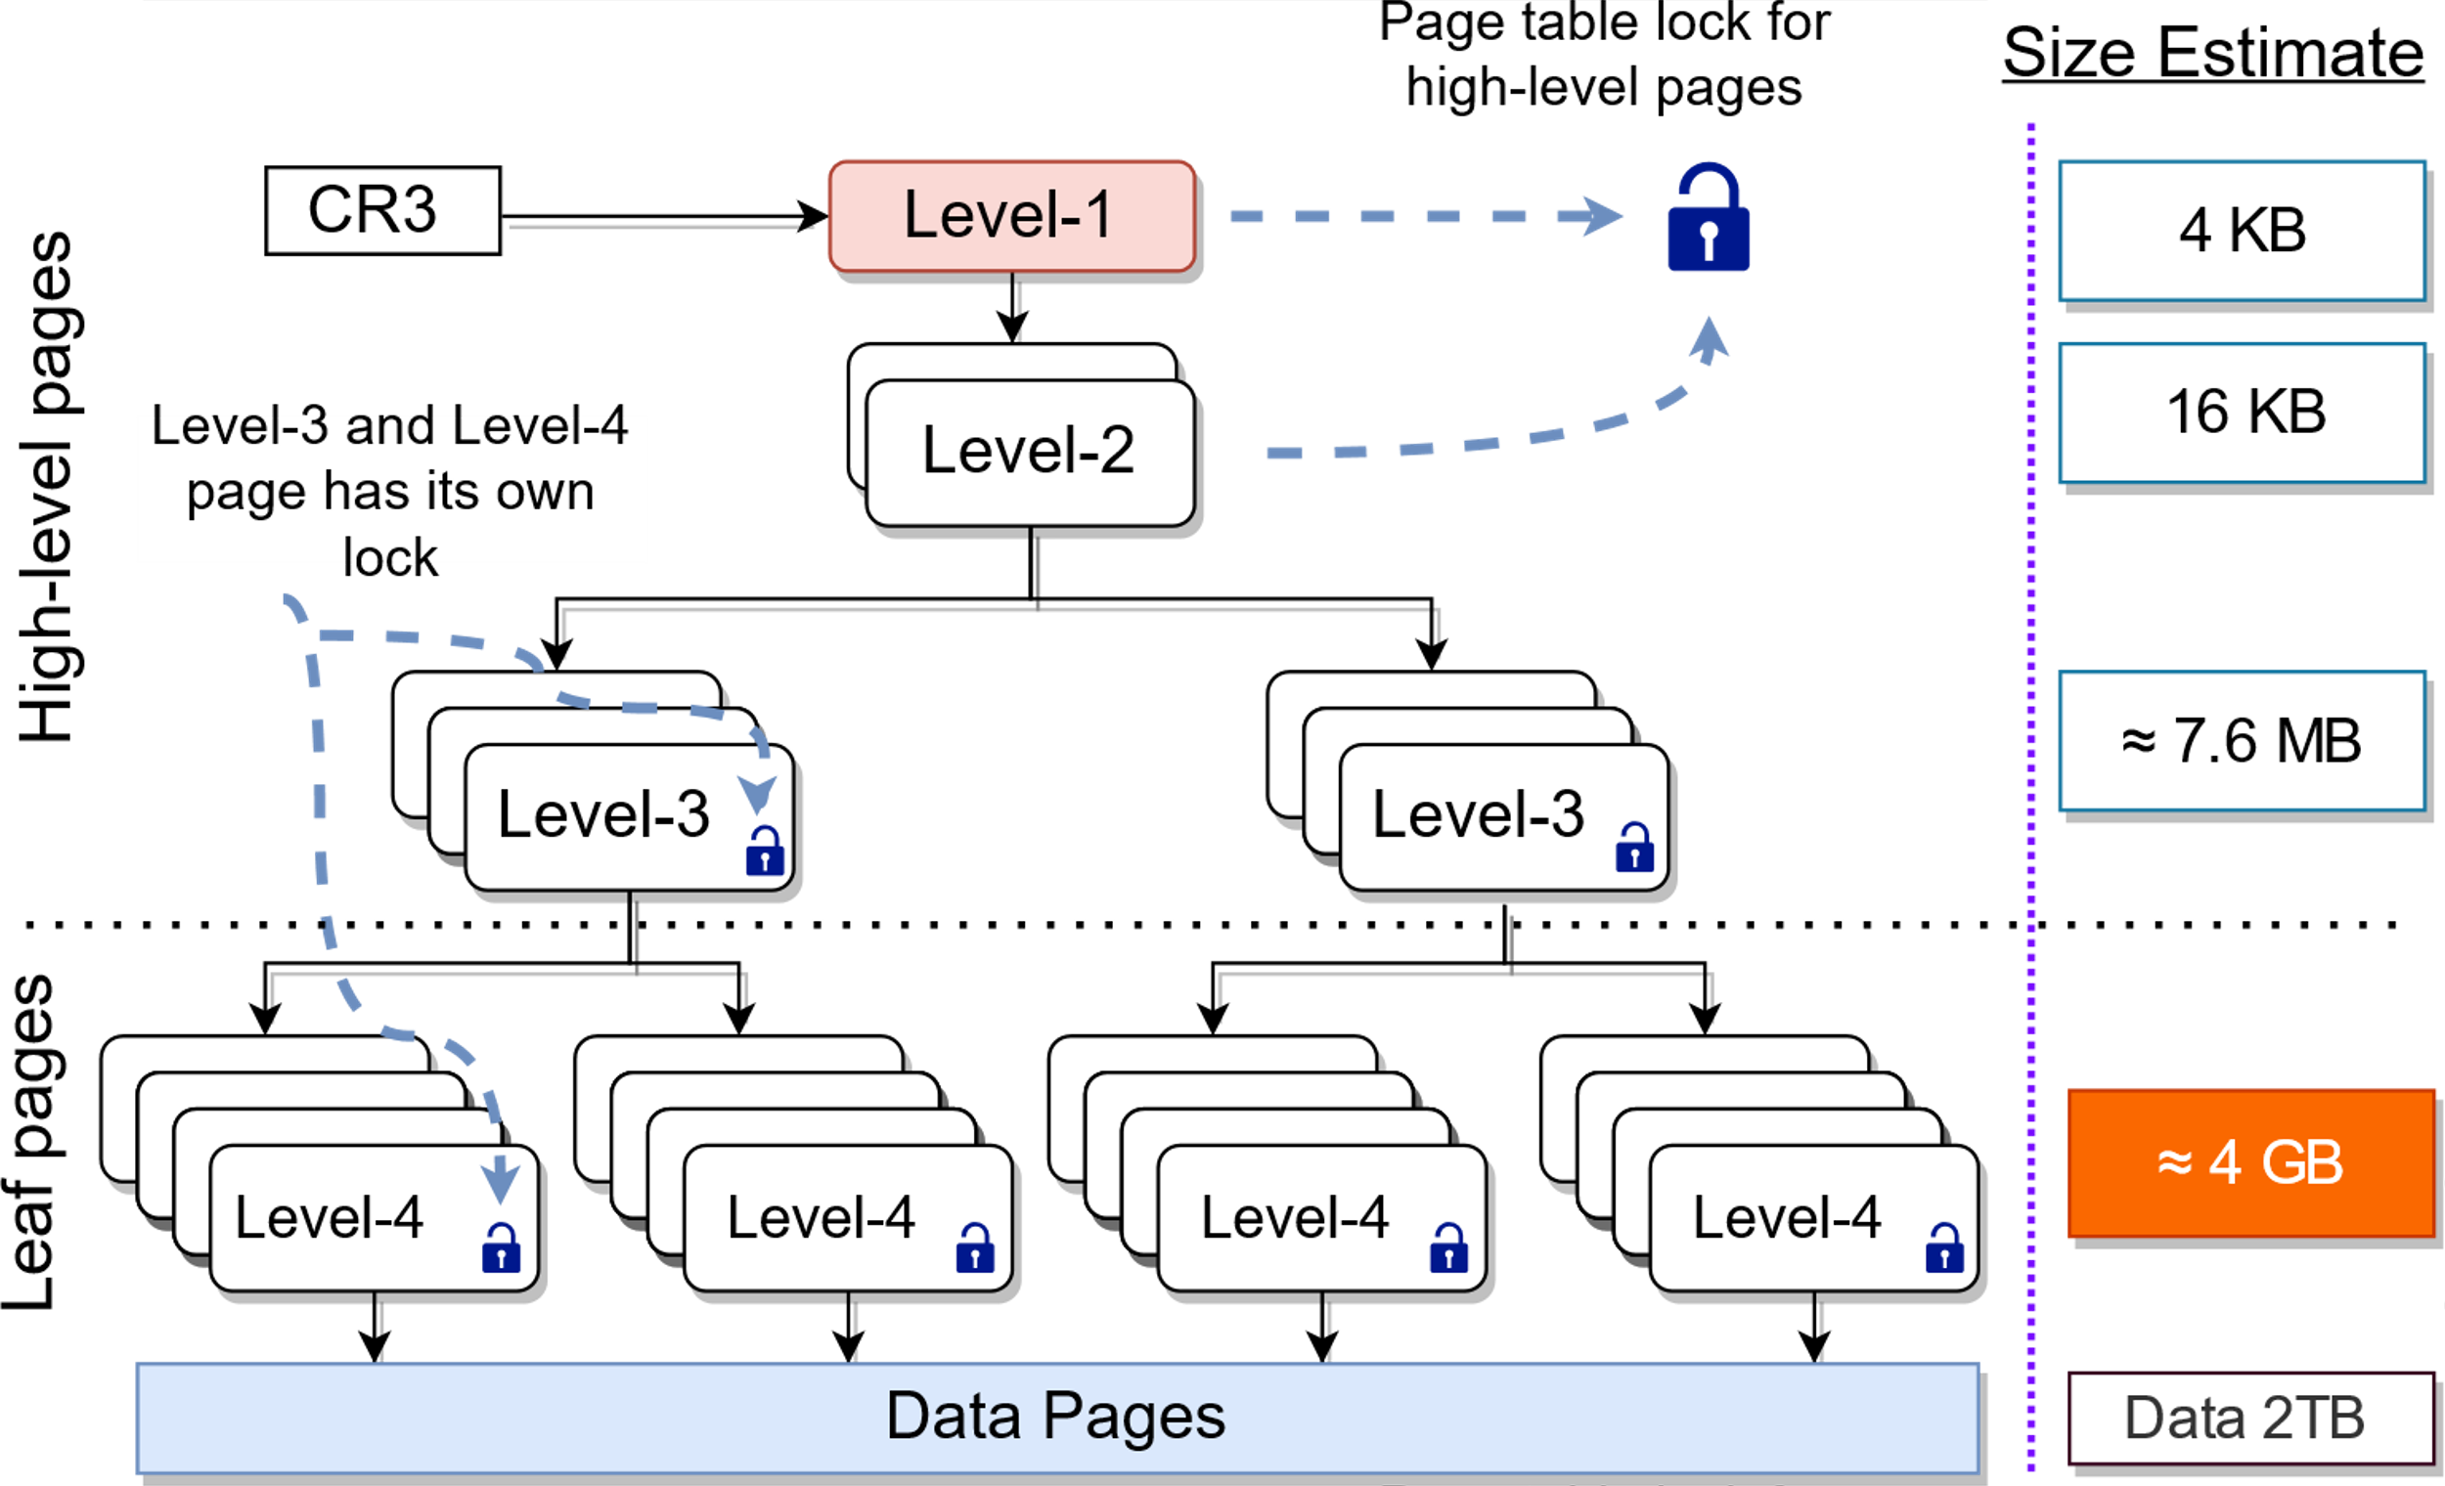
Observation
A 4-level page table
The last-level of the page table accounts for more than 99 % of page table total size.
To map 2 TB of data, a 4-level page table of size 4.008 GB is required.
The size of the last-level of the page table is 4 GB.

Slide 25
Radiant Technique 1 Bind-High
Pin high-level pages to
the DRAM
Pros:
Low space overhead
3 out of 4 memory accesses during a page walk is always from DRAM
We pin 0.2% of the page table pages.
Cons:
The last level pages can still be in Optane.
Notes:
Nominal tradeoff

Slide 26
Radiant Technique 2 Bind-High + Migrate
Pin high-level pages to
DRAM
Pros:
Low space overhead
Leaf-level hot page table pages can be migrated
Enable migrations between DRAM and Optane for the leaf-level pages

Slide 27
Enabling Migrations (Leaf-level pages)
Data pages
NUMA Node 1
NUMA Node 2
Radiant
Page table pages

Slide 28
Enabling Migrations (Leaf-level pages)
Data-page-migration triggered migration
Derive the hotness from the data pages
No additional structures are required
No additional tracking is required
Independent of the data migration policies
NUMA Node 1
NUMA Node 2
Radiant

Slide 29
Evaluation
Workbench:
Intel(R) Xeon(R) Gold 6252N CPU 96 cores (2x2x24)
384 GB DRAM
1.6 TB Optane
Linux kernel 5.6.0

Slide 30
Machine layout

Slide 31
Evaluation
Radiant improves walk latency
Improvement in the page walk latency with Radiant for the interleaved policy (Memcached, RSS 1 TB, 100% read).
Notes:
Default and Radiant
No Bind-high

Slide 32
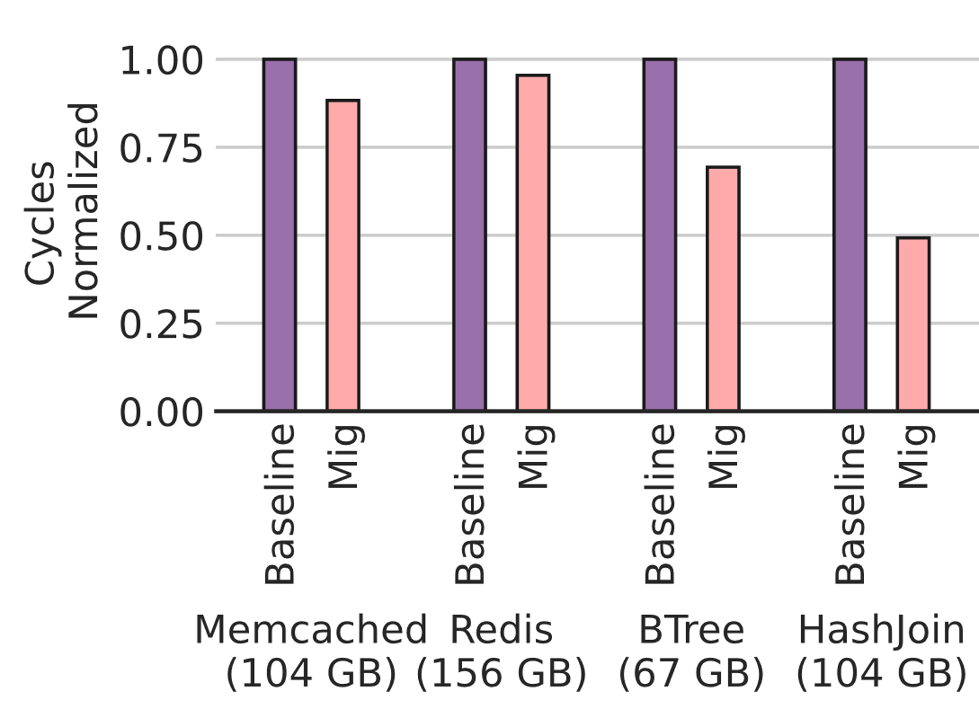
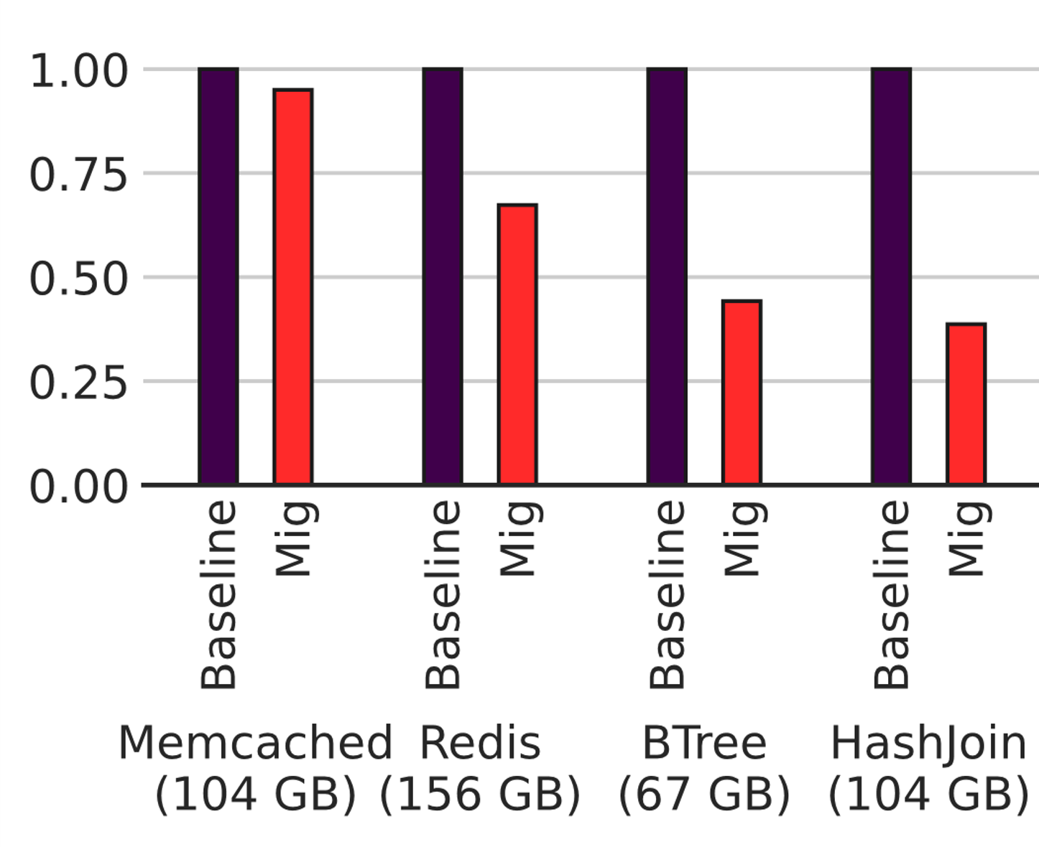
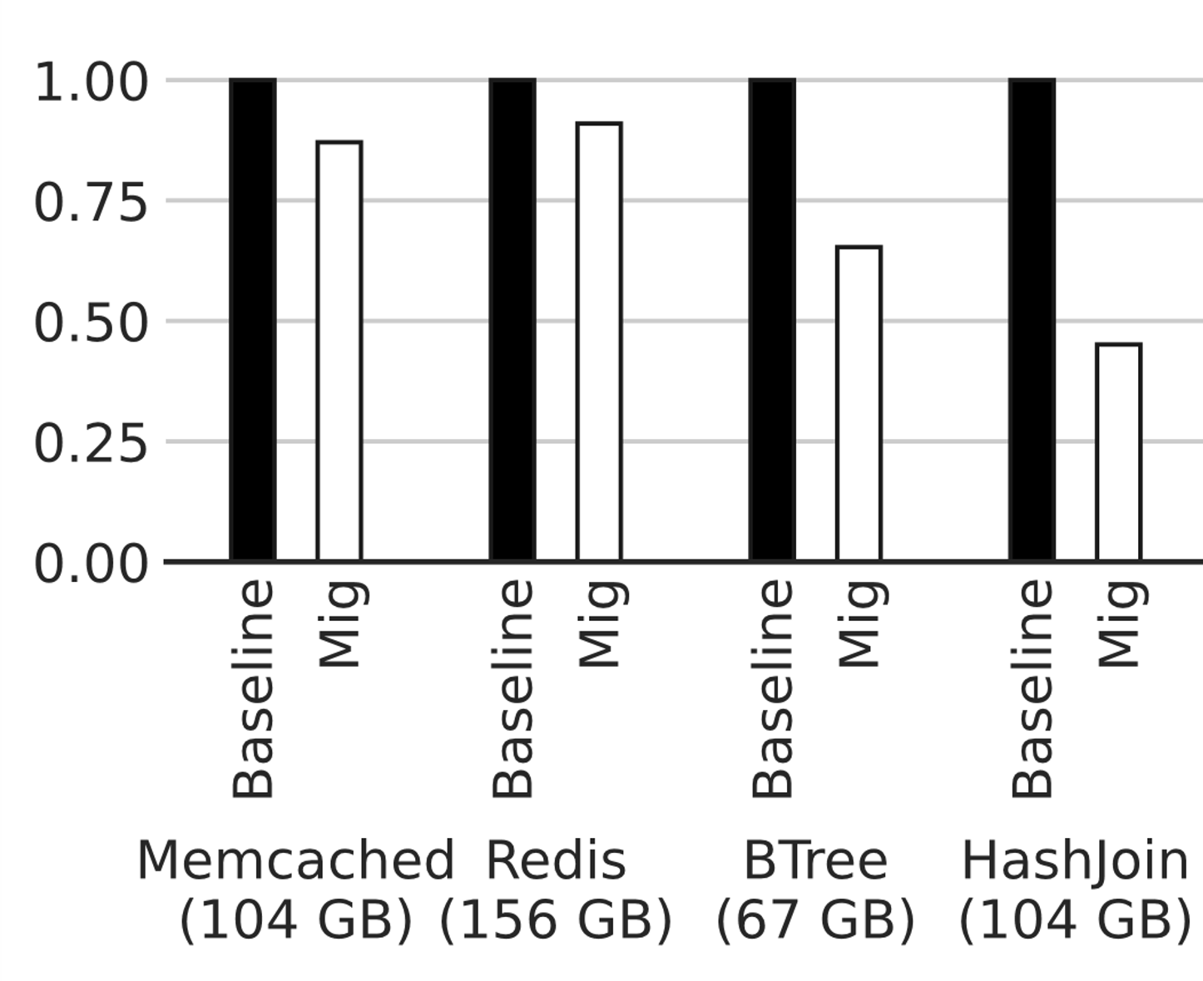
System-wide
Performance improvement of 20% on an average.
Total Cycles
Walk Cycles
Stall Cycles
Multi-tenant
Performance improvement of 50% on an average.
Notes:
TODO Add the labels

Slide 33
Conclusion

Slide 34
Conclusion
Page table placement on tiered memory systems with terabytes of memory is important.
Naïve solution results in pathological behaviors.
Leverage page table structure to devise simple, yet efficient, page table placement policies
Differentiating placement policies for high and low level of page table pages
We use a data-page-migration tiggered page table migration

Slide 35
Thank you Contact: sandeep.kumar@cse.iitd.ac.in aravinda.prasad@intel.com srsarangi@cse.iitd.ac.in sreenivas.subramoney@intel.com

